Slide 1


Ethical Considerations in Data Science
Data science has become a powerful tool, but with great power comes great responsibility. Examining the ethical implications of data-driven decision making is crucial as the field continues to evolve.
Ma
by Muhammad Usman Ghani

Slide 2

Privacy and Consent
Data science often involves collecting and analyzing sensitive personal information. Ensuring individual privacy and obtaining proper consent from data subjects should be a top priority for ethical data practitioners.

Slide 3
Bias and Fairness
1
Algorithmic Bias
2
Representational Bias
3
Transparency and Explainability
Data and algorithms can reflect and amplify existing societal biases, leading to unfair or discriminatory decisions. Proactively identifying and mitigating these biases is essential.
Datasets that do not accurately reflect the diversity of the population can result in models that fail to generalize. Inclusive data collection is crucial.
Data scientists should strive to make their models and decision-making processes transparent and interpretable, allowing for accountability.

Slide 4
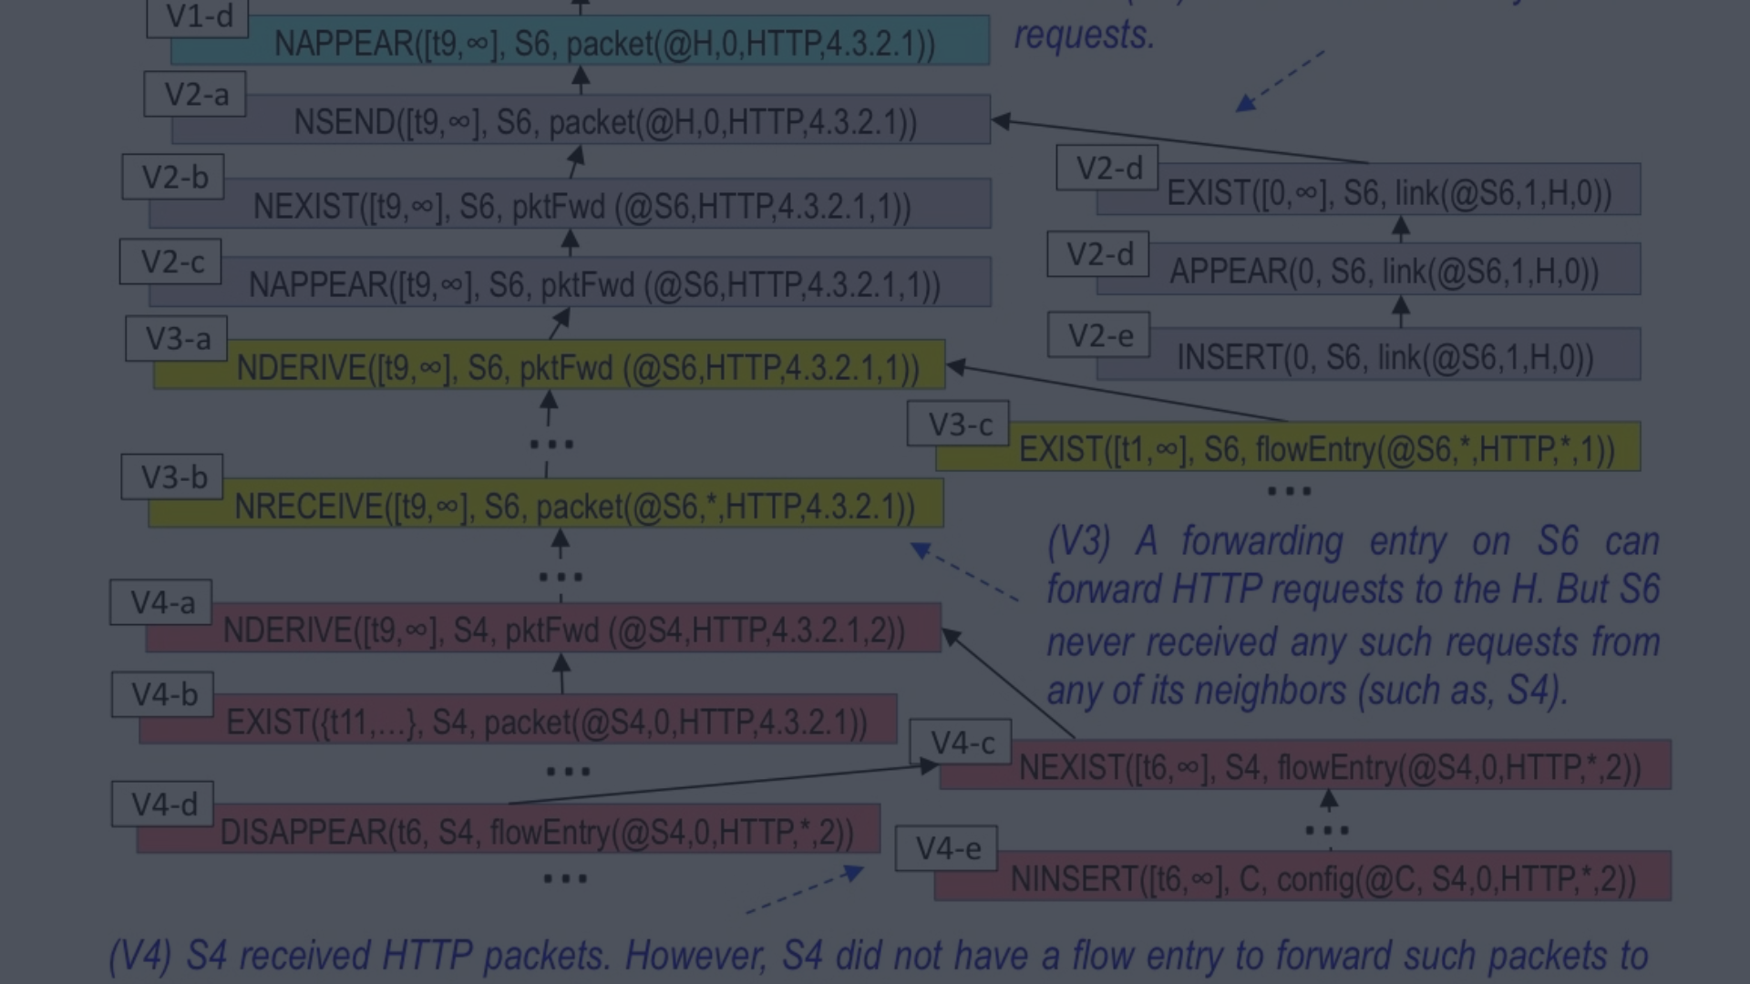
Data Provenance and Integrity
Data Lineage
Data Integrity
Responsible Data Sourcing
Understanding the origin, transformation, and quality of data is essential to ensure its trustworthiness and appropriateness for a given use case.
Implementing robust data validation and quality control measures can prevent the propagation of errors or manipulation, protecting the integrity of insights.
Data scientists should carefully vet the sources of their data and ensure they have the necessary rights and permissions to use it.

Slide 5
Ethical Data Use
Beneficence
Non-Maleficence
Justice and Equity
Data science projects should be designed to maximize benefits and minimize potential harms to individuals and society.
Data scientists have a responsibility to avoid using data in ways that could cause unintended negative consequences.
The insights and applications of data science should be distributed fairly, without disproportionately favoring or disadvantaging particular groups.

Slide 6
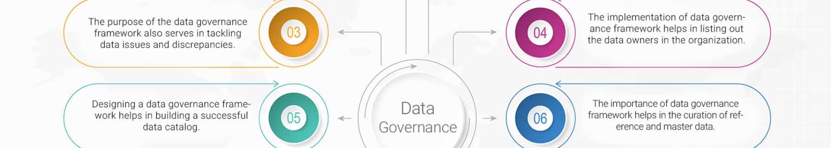



Accountability and Governance
Ethical Frameworks
Organizational Policies
Oversight and Auditing
Developing and adhering to clear ethical frameworks can guide decision-making and hold data practitioners accountable.
Implementing robust data governance policies and processes can ensure ethical data practices are consistently followed.
Regular audits and external oversight can help identify and address ethical issues in data science projects.

Slide 7



Continuous Learning and Improvement
Education
Collaboration
Research
Ongoing training and education in ethical data science practices should be a priority for individuals and organizations.
Cross-disciplinary collaboration and knowledge sharing can foster a culture of ethical data science.
Continued research and investigation into the ethical implications of data science can drive progress in the field.

Slide 8
The Path Forward
Embrace Ethical Principles
Proactively incorporate ethical considerations into every stage of the data science lifecycle.
Foster Ethical Culture
Cultivate an organizational culture that prioritizes ethical data practices and accountability.
Engage Stakeholders
Collaborate with diverse stakeholders to identify and address ethical challenges in data-driven decision making.

